Slide 1
Multilayer Perceptron 多層感知機
A multilayer perceptron is a type of feedforward neural network consisting of fully connected neurons with a nonlinear kind of activation function. It is widely used to distinguish data that is not linearly separable.
Input layer The input layer consists of nodes or neurons that receive the initial input data. Each neuron represents a feature or dimension of the input data. The number of neurons in the input layer is determined by the dimensionality of the input data.
Hidden layer Between the input and output layers, there can be one or more layers of neurons. Each neuron in a hidden layer receives inputs from all neurons in the previous layer (either the input layer or another hidden layer) and produces an output that is passed to the next layer. The number of hidden layers and the number of neurons in each hidden layer are hyperparameters that need to be determined during the model design phase.
Output layer This layer consists of neurons that produce the final output of the network. The number of neurons in the output layer depends on the nature of the task. In binary classification, there may be either one or two neurons depending on the activation function and representing the probability of belonging to one class; while in multi-class classification tasks, there can be multiple neurons in the output layer.
https://www.datacamp.com/tutorial/multilayer-perceptrons-in-machine-learning

Slide 2
Weights Neurons in adjacent layers are fully connected to each other. Each connection has an associated weight, which determines the strength of the connection. These weights are learned during the training process.
Bias Neurons In addition to the input and hidden neurons, each layer (except the input layer) usually includes a bias neuron that provides a constant input to the neurons in the next layer. The bias neuron has its own weight associated with each connection, which is also learned during training.
Activation Function Typically, each neuron in the hidden layers and the output layer applies an activation function to its weighted sum of inputs. Common activation functions include sigmoid, tanh, ReLU (Rectified Linear Unit), and softmax. These functions introduce nonlinearity into the network, allowing it to learn complex patterns in the data.
Training with Backpropagation MLPs are trained using the backpropagation algorithm, which computes gradients of a loss function with respect to the model's parameters and updates the parameters iteratively to minimize the loss.
https://www.datacamp.com/tutorial/multilayer-perceptrons-in-machine-learning

Slide 3


Multi-Layer Perceptron
Input Layer Hidden Layers Output Layer Ground Truth
x h₁ h₂ … h_{n} $\hat{y}$ y
x₁
x₂
.
.
.
x_{d}
$\hat{y}$₁
$\hat{y}$₂
.
.
.
$$\hat{y}n$$
$$y_{1}$$
$$y_{2}$$
.
.
.
$$y_{n}$$
…
…
…
…
…

Slide 4
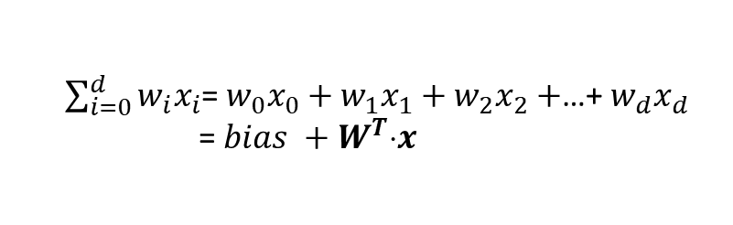
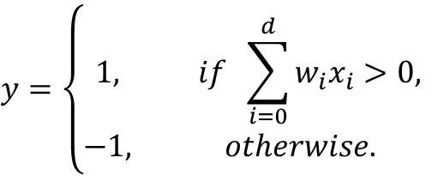
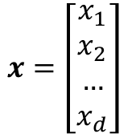
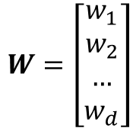
Perceptron –fundamental unit of a Neural Network
1
weights
w₀
w₁
w₂
.
.
.
w_{d}
x₁
Output
x₂
$$y=\left\{\begin{aligned}1, if \sum_{i=0}^{d}{w_{i}x_{i}>0,} \\ −1, otherwise. \end{aligned}\right.$$
_{Σ}
.
.
.
Activation function
x_{d}
$\sum_{i=0}^{d}{w_{i}x_{i}}$= $w_{0}x_{0}+w_{1}x_{1}+w_{2}x_{2}+$…+ $w_{d}x_{d}$
= $bias +W^{T}x$
$W=\left[\begin{aligned}w_{1} \\ w_{2} \\ … \\ w_{d}\end{aligned}\right]$
$x=\left[\begin{aligned}x_{1} \\ x_{2} \\ … \\ x_{d}\end{aligned}\right]$
Inputs

Slide 5
Input layer
The input layer of an MLP receives input data, which could be features extracted from the input samples in a dataset. Each neuron in the input layer represents one feature.
Neurons in the input layer do not perform any computations; they simply pass the input values to the neurons in the first hidden layer.

Slide 6
Hidden layers
The hidden layers of an MLP consist of interconnected neurons that perform computations on the input data.
Each neuron in a hidden layer receives input from all neurons in the previous layer. The inputs are multiplied by corresponding weights, denoted as w. The weights determine how much influence the input from one neuron has on the output of another.
In addition to weights, each neuron in the hidden layer has an associated bias, denoted as b. The bias provides an additional input to the neuron, allowing it to adjust its output threshold. Like weights, biases are learned during training.
For each neuron in a hidden layer or the output layer, the weighted sum of its inputs is computed. This involves multiplying each input by its corresponding weight, summing up these products, and adding the bias.

Slide 7
Output layer
The output layer of an MLP produces the final predictions or outputs of the network. The number of neurons in the output layer depends on the task being performed (e.g., binary classification, multi-class classification, regression).
Each neuron in the output layer receives input from the neurons in the last hidden layer and applies an activation function. This activation function is usually different from those used in the hidden layers and produces the final output value or prediction.

Slide 8
Training
During the training process, the network learns to adjust the weights associated with each neuron's inputs to minimize the discrepancy between the predicted outputs and the true target values in the training data. By adjusting the weights and learning the appropriate activation functions, the network learns to approximate complex patterns and relationships in the data, enabling it to make accurate predictions on new, unseen samples.
This adjustment is guided by an optimization algorithm, such as stochastic gradient descent (SGD), which computes the gradients of a loss function with respect to the weights and updates the weights iteratively.

Slide 9
Stochastic Gradient Descent (SGD)
Initialization: SGD starts with an initial set of model parameters (weights and biases) randomly or using some predefined method.
Iterative Optimization: The aim of this step is to find the minimum of a loss function, by iteratively moving in the direction of the steepest decrease in the function's value.

Slide 10
For each iteration (or epoch) of training:
Shuffle the training data to ensure that the model doesn't learn from the same patterns in the same order every time.
Split the training data into mini-batches (small subsets of data).
For each mini-batch:
Compute the gradient of the loss function with respect to the model parameters using only the data points in the mini-batch. This gradient estimation is a stochastic approximation of the true gradient.
Update the model parameters by taking a step in the opposite direction of the gradient, scaled by a learning rate:
Θ_{t+1} = θ_{t} - n * ⛛ J (θ_{t})
Where:
θ_{t} represents the model parameters at iteration t. This parameter can be the weight
⛛ J (θ_{t}) is the gradient of the loss function J with respect to the parameters θ_{t}
n is the learning rate, which controls the size of the steps taken during optimization.

Slide 11
Stochastic Gradient Descent (SGD)
Direction of Descent: The gradient of the loss function indicates the direction of the steepest ascent. To minimize the loss function, gradient descent moves in the opposite direction, towards the steepest descent.
Learning Rate: The step size taken in each iteration of gradient descent is determined by a parameter called the learning rate, denoted above as n. This parameter controls the size of the steps taken towards the minimum. If the learning rate is too small, convergence may be slow; if it is too large, the algorithm may oscillate or diverge.
Convergence: Repeat the process for a fixed number of iterations or until a convergence criterion is met (e.g., the change in loss function is below a certain threshold).

Slide 12
Stochastic gradient descent updates the model parameters more frequently using smaller subsets of data, making it computationally efficient, especially for large datasets. The randomness introduced by SGD can have a regularization effect, preventing the model from overfitting to the training data. It is also well-suited for online learning scenarios where new data becomes available incrementally, as it can update the model quickly with each new data point or mini-batch.
However, SGD can also have some challenges, such as increased noise due to the stochastic nature of the gradient estimation and the need to tune hyperparameters like the learning rate.
Various extensions and adaptations of SGD, such as mini-batch stochastic gradient descent, momentum, and adaptive learning rate methods like AdaGrad, RMSProp, and Adam, have been developed to address these challenges and improve convergence and performance.

Slide 13
Backpropagation
Backpropagation is short for “backward propagation of errors.” In the context of backpropagation, SGD involves updating the network's parameters iteratively based on the gradients computed during each batch of training data. Instead of computing the gradients using the entire training dataset (which can be computationally expensive for large datasets), SGD computes the gradients using small random subsets of the data called mini-batches.

Slide 14
Forward pass: During the forward pass, input data is fed into the neural network, and the network's output is computed layer by layer. Each neuron computes a weighted sum of its inputs, applies an activation function to the result, and passes the output to the neurons in the next layer.
Loss computation: After the forward pass, the network's output is compared to the true target values, and a loss function is computed to measure the discrepancy between the predicted output and the actual output.
Backward Pass (Gradient Calculation): In the backward pass, the gradients of the loss function with respect to the network's parameters (weights and biases) are computed using the chain rule of calculus. The gradients represent the rate of change of the loss function with respect to each parameter and provide information about how to adjust the parameters to decrease the loss.
Parameter update: Once the gradients have been computed, the network's parameters are updated in the opposite direction of the gradients in order to minimize the loss function. This update is typically performed using an optimization algorithm such as stochastic gradient descent (SGD), that we discussed earlier.
Iterative Process: Steps 1-4 are repeated iteratively for a fixed number of epochs or until convergence criteria are met. During each iteration, the network's parameters are adjusted based on the gradients computed in the backward pass, gradually reducing the loss and improving the model's performance.

Slide 15
Lab 1 mnistMLP.py
import torch from torch import nn from torch.utils.data import DataLoader from torchvision import datasets from torchvision.transforms import ToTensor import time # Download training data from open datasets. training_data = datasets.FashionMNIST( root="data", train=True, download=True, transform=ToTensor(), ) # Download test data from open datasets. test_data = datasets.FashionMNIST( root="data", train=False, download=True, transform=ToTensor(), ) batch_size = 64 # Create data loaders. train_dataloader = DataLoader(training_data, batch_size=batch_size) test_dataloader = DataLoader(test_data, batch_size=batch_size) for X, y in test_dataloader: print(f"Shape of X [N, C, H, W]: {X.shape}") print(f"Shape of y: {y.shape} {y.dtype}") break #device = torch.accelerator.current_accelerator().type if torch.accelerator.is_available() else "cpu" device = torch.device("cuda" if torch.cuda.is_available() else "cpu") print(f"Using {device} device") # Define model class NeuralNetwork(nn.Module): def __init__(self): super().__init__() self.flatten = nn.Flatten() self.linear_relu_stack = nn.Sequential( nn.Linear(28*28, 512), nn.ReLU(), nn.Linear(512, 512), nn.ReLU(), nn.Linear(512, 10) ) def forward(self, x): x = self.flatten(x) logits = self.linear_relu_stack(x) return logits model = NeuralNetwork().to(device) print(model) loss_fn = nn.CrossEntropyLoss() optimizer = torch.optim.SGD(model.parameters(), lr=1e-3) def train(dataloader, model, loss_fn, optimizer): size = len(dataloader.dataset) model.train() for batch, (X, y) in enumerate(dataloader): X, y = X.to(device), y.to(device) # Compute prediction error pred = model(X) loss = loss_fn(pred, y) # Backpropagation loss.backward() optimizer.step() optimizer.zero_grad() if batch % 100 == 0: loss, current = loss.item(), (batch + 1) * len(X) print(f"loss: {loss:>7f} [{current:>5d}/{size:>5d}]") def test(dataloader, model, loss_fn): size = len(dataloader.dataset) num_batches = len(dataloader) model.eval() test_loss, correct = 0, 0 with torch.no_grad(): for X, y in dataloader: X, y = X.to(device), y.to(device) pred = model(X) test_loss += loss_fn(pred, y).item() correct += (pred.argmax(1) == y).type(torch.float).sum().item() test_loss /= num_batches correct /= size print(f"Test Error: \n Accuracy: {(100*correct):>0.1f}%, Avg loss: {test_loss:>8f} \n") if __name__ == "__main__": epochs = 10 start_time = time.time() # 記錄開始時間 for t in range(epochs): print(f"Epoch {t+1}\n-------------------------------") train(train_dataloader, model, loss_fn, optimizer) test(test_dataloader, model, loss_fn) end_time = time.time() # 記錄結束時間 elapsed = end_time - start_time print(f"Total training time: {elapsed:.2f} seconds ({elapsed / 60:.2f} minutes)") print("Done!")

Slide 16

MLP MNIST Classification
Find the problem to be solve (tool to be provided)
Example: Build an automatic letter dispatching system
Kernel program: zip code recognition (郵遞區號辨識)
學習辨識1張28×28圖片的內容是0, 1, 2, …, or 9?
用FashionMNIST dataset/ Multilayer Perceptron Network
Establish the system (implementation)
Data
Model
Objective Function
Optimization Algorithm
https://docs.pytorch.org/tutorials/beginner/basics/quickstart_tutorial.html

Slide 17
Learning path 學習路徑
Run the sample program to check the result
執行範例程式檢視結果
Understand the meaning and usage of each command by tracing the code line by line
追蹤程式碼，查詢並了解每個指令意義與用法

Slide 18
import torch from torch import nn from torch.utils.data import DataLoader from torchvision import datasets from torchvision.transforms import ToTensor # Download training data from open datasets. training_data = datasets.MNIST( root="data", train=True, download=True, transform=ToTensor(), ) # Download test data from open datasets. test_data = datasets.MNIST( root="data", train=False, download=True, transform=ToTensor(), )

Slide 19
batch_size = 64 # Create data loaders. train_dataloader = DataLoader(training_data, batch_size=batch_size) test_dataloader = DataLoader(test_data, batch_size=batch_size) for X, y in test_dataloader: print(f"Shape of X [N, C, H, W]: {X.shape}") print(f"Shape of y: {y.shape} {y.dtype}") break device = "cuda" if torch.cuda.is_available() else "cpu" print(f"Using {device} device")
Shape of X [N, C, H, W]: torch.Size([64, 1, 28, 28])
Shape of y: torch.Size([64]) torch.int64
Using cuda device

Slide 20
# Define model class NeuralNetwork(nn.Module): def __init__(self): super().__init__() self.flatten = nn.Flatten() self.linear_relu_stack = nn.Sequential( nn.Linear(28*28, 512), nn.ReLU(), nn.Linear(512, 512), nn.ReLU(), nn.Linear(512, 10) ) def forward(self, x): x = self.flatten(x) logits = self.linear_relu_stack(x) return logits model = NeuralNetwork().to(device) print(model) loss_fn = nn.CrossEntropyLoss() optimizer = torch.optim.SGD(model.parameters(), lr=1e-3)
x₁
x₂
.
.
.
x₇₈₄
0
1
.
.
.
9
…
…
…
…
28×28=784 512 512 10
NeuralNetwork(
(flatten): Flatten(start_dim=1, end_dim=-1)
(linear_relu_stack): Sequential(
(0): Linear(in_features=784, out_features=512, bias=True)
(1): ReLU()
(2): Linear(in_features=512, out_features=512, bias=True)
(3): ReLU()
(4): Linear(in_features=512, out_features=10, bias=True)
)
)

Slide 21
def train(dataloader, model, loss_fn, optimizer): size = len(dataloader.dataset) model.train()
for batch, (X, y) in enumerate(dataloader): X, y = X.to(device), y.to(device) # Compute prediction error pred = model(X) loss = loss_fn(pred, y) # Backpropagation loss.backward() optimizer.step() optimizer.zero_grad() if batch % 100 == 0: loss, current = loss.item(), (batch + 1) * len(X) print(f"loss: {loss:>7f} [{current:>5d}/{size:>5d}]")

Slide 22
def test(dataloader, model, loss_fn): size = len(dataloader.dataset) num_batches = len(dataloader) model.eval() test_loss, correct = 0, 0 with torch.no_grad(): for X, y in dataloader: X, y = X.to(device), y.to(device) pred = model(X) test_loss += loss_fn(pred, y).item() correct += (pred.argmax(1) == y).type(torch.float).sum().item() test_loss /= num_batches correct /= size print(f"Test Error: \n Accuracy: {(100*correct):>0.1f}%, Avg loss: {test_loss:>8f} \n") if __name__ == "__main__": epochs = 5 for t in range(epochs): print(f"Epoch {t+1}\n-------------------------------") train(train_dataloader, model, loss_fn, optimizer) test(test_dataloader, model, loss_fn) print("Done!")
Epoch 1
-------------------------------
loss: 2.313558 [ 64/60000]
loss: 2.303183 [ 6464/60000]…
Epoch 10
-------------------------------
loss: 0.827288 [ 64/60000]
loss: 0.908000 [ 6464/60000]
loss: 0.669429 [12864/60000]
loss: 0.862134 [19264/60000]
loss: 0.779562 [25664/60000]
loss: 0.768864 [32064/60000]
loss: 0.844356 [38464/60000]
loss: 0.797493 [44864/60000]
loss: 0.824290 [51264/60000]
loss: 0.776216 [57664/60000]
Test Error:
Accuracy: 71.4%, Avg loss: 0.783415
Total training time: 95.73 seconds (1.60 minutes)
Done!

Slide 23
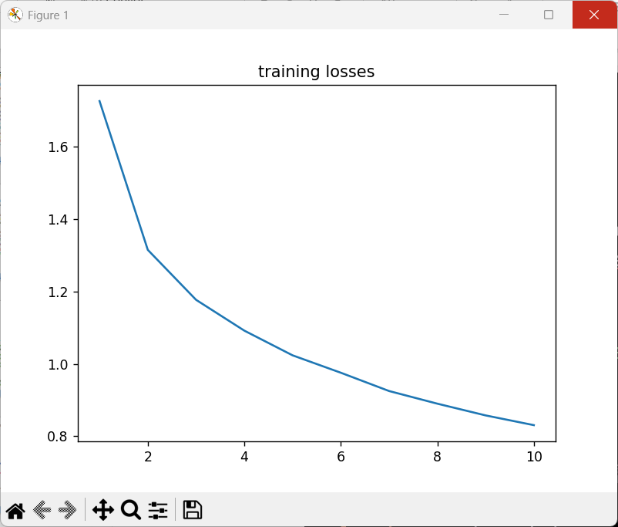
Lab 2 CIFAR10Training.py
import torch import torch.nn as nn import torch.nn.functional as F import torch.optim as optim import torchvision import torchvision.transforms as transforms import matplotlib.pyplot as plt import numpy as np classes = ('plane', 'car', 'bird', 'cat', 'deer', 'dog', 'frog', 'horse', 'ship', 'truck') transform = transforms.Compose([transforms.ToTensor(), transforms.Normalize((0.5, 0.5, 0.5), (0.5, 0.5, 0.5))]) batch_size = 4 trainset = torchvision.datasets.CIFAR10(root='../data', train=True, download=True, transform=transform) trainloader = torch.utils.data.DataLoader(trainset, batch_size=batch_size, shuffle=True) device = "cuda" if torch.cuda.is_available() else "cpu" print('Using {} device'.format(device)) class LeNet5(nn.Module): def __init__(self): super().__init__() self.conv1 = nn.Conv2d(3, 6, 5) self.pool = nn.MaxPool2d(2, 2) self.conv2 = nn.Conv2d(6, 16, 5) self.fc1 = nn.Linear(16 * 5 * 5, 120) self.fc2 = nn.Linear(120, 84) self.fc3 = nn.Linear(84, 10) def forward(self, x): x = self.pool(F.relu(self.conv1(x))) x = self.pool(F.relu(self.conv2(x))) x = torch.flatten(x, 1) # flatten all dimensions except batch x = F.relu(self.fc1(x)) x = F.relu(self.fc2(x)) x = self.fc3(x) return x net = LeNet5().to(device) criterion = nn.CrossEntropyLoss() optimizer = optim.SGD(net.parameters(), lr=0.001, momentum=0.9) losses = [] num_epocs = 10 # loop over the dataset multiple times for epoch in range(num_epocs): running_loss = 0.0 for i, (X, y) in enumerate(trainloader, 0): # get the inputs; data is a list of [inputs, labels] inputs, labels = X.to(device), y.to(device) # zero the parameter gradients optimizer.zero_grad() # forward + backward + optimize outputs = net(inputs) loss = criterion(outputs, labels) loss.backward() optimizer.step() # print statistics running_loss += loss.item() print(f'epoch: {epoch+1} loss:{running_loss/len(trainloader):.4f}') losses.append(running_loss/len(trainloader)) plt.title('training losses') plt.plot(np.arange(1, num_epocs+1), losses) plt.show() print('Finished Training') PATH = './cifar_net.pth' torch.save(net.state_dict(), PATH) print('model saved.')
C:\Users\user\anaconda3\envs\torch5800\python.exe E:\Pytorch\L004_MLP\CIFAR10Training.py
Using cuda device
epoch: 1 loss:1.7264
epoch: 2 loss:1.3152
epoch: 3 loss:1.1772
epoch: 4 loss:1.0920
epoch: 5 loss:1.0238
epoch: 6 loss:0.9756
epoch: 7 loss:0.9251
epoch: 8 loss:0.8901
epoch: 9 loss:0.8577
epoch: 10 loss:0.8308
Finished Training
model saved.
Process finished with exit code 0

Slide 24
Lab 2 CIFAR10Evaluation.py
import torch import torch.nn as nn import torch.nn.functional as F import torchvision import torchvision.transforms as transforms import matplotlib.pyplot as plt import numpy as np classes = ('plane', 'car', 'bird', 'cat', 'deer', 'dog', 'frog', 'horse', 'ship', 'truck') transform = transforms.Compose([transforms.ToTensor(), transforms.Normalize((0.5, 0.5, 0.5), (0.5, 0.5, 0.5))]) batch_size = 4 testset = torchvision.datasets.CIFAR10(root='../data', train=False, download=True, transform=transform) testloader = torch.utils.data.DataLoader(testset, batch_size=batch_size, shuffle=False) PATH = './cifar_net.pth' device = "cuda" if torch.cuda.is_available() else "cpu" class Net(nn.Module): def __init__(self): super().__init__() self.conv1 = nn.Conv2d(3, 6, 5) self.pool = nn.MaxPool2d(2, 2) self.conv2 = nn.Conv2d(6, 16, 5) self.fc1 = nn.Linear(16 * 5 * 5, 120) self.fc2 = nn.Linear(120, 84) self.fc3 = nn.Linear(84, 10) def forward(self, x): x = self.pool(F.relu(self.conv1(x))) x = self.pool(F.relu(self.conv2(x))) x = torch.flatten(x, 1) # flatten all dimensions except batch x = F.relu(self.fc1(x)) x = F.relu(self.fc2(x)) x = self.fc3(x) return x net = Net().to(device) net.load_state_dict(torch.load(PATH)) correct = 0 total = 0 # since we're not training, we don't need to calculate the gradients for our outputs with torch.no_grad(): for (X, y) in testloader: images, labels = X.to(device), y.to(device) # calculate outputs by running images through the network outputs = net(images) # the class with the highest energy is what we choose as prediction _, predicted = torch.max(outputs.data, 1) total += labels.size(0) correct += (predicted == labels).sum().item() print(f'\nAccuracy of the network on the 10000 test images: {100 * correct // total} %') # prepare to count predictions for each class correct_pred = {classname: 0 for classname in classes} total_pred = {classname: 0 for classname in classes} # again no gradients needed with torch.no_grad(): for (X, y) in testloader: images, labels = X.to(device), y.to(device) outputs = net(images) _, predictions = torch.max(outputs, 1) # collect the correct predictions for each class for label, prediction in zip(labels, predictions): if label == prediction: correct_pred[classes[label]] += 1 total_pred[classes[label]] += 1 # print accuracy for each class for classname, correct_count in correct_pred.items(): accuracy = 100 * float(correct_count) / total_pred[classname] print(f'Accuracy for class: {classname:5s} is {accuracy:.1f} %') print('done!')
C:\Users\user\anaconda3\envs\torch5800\python.exe E:\Pytorch\L004_MLP\CIFAR10Evaluation.py
Accuracy of the network on the 10000 test images: 61 %
Accuracy for class: plane is 47.0 %
Accuracy for class: car is 75.1 %
Accuracy for class: bird is 56.6 %
Accuracy for class: cat is 36.9 %
Accuracy for class: deer is 47.8 %
Accuracy for class: dog is 55.2 %
Accuracy for class: frog is 80.5 %
Accuracy for class: horse is 61.7 %
Accuracy for class: ship is 78.5 %
Accuracy for class: truck is 78.9 %
done!
Process finished with exit code 0

Slide 25
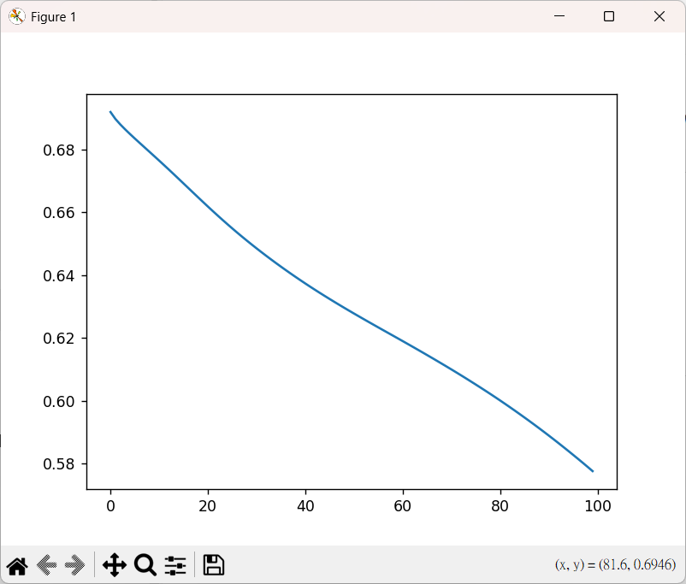
Lab 3 CatDogMLP.py
import torch from torch import nn from torch.utils.data import DataLoader from torchvision import datasets import torchvision.transforms as transforms import matplotlib.pyplot as plt transforms = transforms.Compose([transforms.Grayscale(), transforms.Resize((28, 28)), transforms.ToTensor(), transforms.Normalize(mean=(0.5), std=(0.5)), ]) # Load training data from Image Folder dataAll = datasets.ImageFolder( root="../data/kagglecatsanddogs_5340/PetImages", transform = transforms, ) num_datapoints = len(dataAll) print(num_datapoints) # split training data into two parts # training_set(70%) # validation_set(30%) train_size = int(0.7 * len(dataAll)) test_size = len(dataAll) - train_size train_set, test_set = torch.utils.data.random_split(dataAll, [train_size, test_size]) # Create data loaders. batch_size = 32 train_dataloader = DataLoader(train_set, batch_size=batch_size) test_dataloader = DataLoader(test_set, batch_size=batch_size) for X, y in train_dataloader: print(f"Shape of X [N, C, H, W]: {X.shape}") print(f"Shape of y: {y.shape} {y.dtype}\n") break # Get cpu or gpu device for training. device = "cuda" if torch.cuda.is_available() else "cpu" print(f"Using {device} device") # Define model class NeuralNetwork(nn.Module): def __init__(self): super().__init__() self.flatten = nn.Flatten() self.linear_relu_stack = nn.Sequential( nn.Linear(28*28, 512), nn.ReLU(), nn.Linear(512, 512), nn.ReLU(), nn.Linear(512, 2) ) def forward(self, x): x = self.flatten(x) logits = self.linear_relu_stack(x) return logits model = NeuralNetwork().to(device) print(model) loss_fn = nn.CrossEntropyLoss() optimizer = torch.optim.SGD(model.parameters(), lr=1e-3) learnloss = [] def train(dataloader, model, loss_fn, optimizer): size = len(dataloader) model.train() training_loss = 0.0 for batch, (X, y) in enumerate(dataloader): X, y = X.to(device), y.to(device) # Compute prediction error pred = model(X) loss = loss_fn(pred, y) # Backpropagation loss.backward() optimizer.step() optimizer.zero_grad() training_loss += loss.item() training_loss /= size learnloss.append(training_loss) def test(dataloader, model, loss_fn): size = len(dataloader.dataset) num_batches = len(dataloader) model.eval() test_loss, correct = 0, 0 with torch.no_grad(): for X, y in dataloader: X, y = X.to(device), y.to(device) pred = model(X) test_loss += loss_fn(pred, y).item() correct += (pred.argmax(1) == y).type(torch.float).sum().item() test_loss /= num_batches correct /= size print(f"Test Error: \n Accuracy: {(100*correct):>0.1f}%, Avg loss: {test_loss:>8f} \n") epochs = 100 for t in range(epochs): print(f"Epoch {t+1}\n-------------------------------") train(train_dataloader, model, loss_fn, optimizer) plt.plot(learnloss) plt.show() test(test_dataloader, model, loss_fn) print("Done!")

